Slide 1
Module 2: Data Collection & Sampling Methods

Slide 2
Contents
Primary & Secondary data
Sources of data
Methods of collecting data.
Sampling – Census & Sample methods
Methods of sampling
Probability Sampling and Non-Probability Sampling

Slide 3
What is Data?
Data is a collection of facts, figures, objects, symbols and events gathered from different sources
Organization collects data to make better decisions from time to time
Example: Launching product

Slide 4
Data Collection
Definition:
It is a process of collecting information from all the relevant sources to find answers to the research problem, test the hypotheses and evaluate the outcomes

Slide 5
Sources of Data
Basis (Statistics)
Non-statistical Sources
Collection of data for other administrative purposes
Data that are gathered for some official purposes
officially administered surveys
incorporate censuses
Basis (Origin)
Collection of Data in Private Sector
Statistical Sources
Internal Sources
data are collected from reports and records of the organization itself
External Sources
Example: A company publishes its annual report on profit and loss, total sales, loan, wages
When data are collected from outside the organization
Example: Tour and travel company obtains data from ‘Karnataka Transportation’

Slide 6
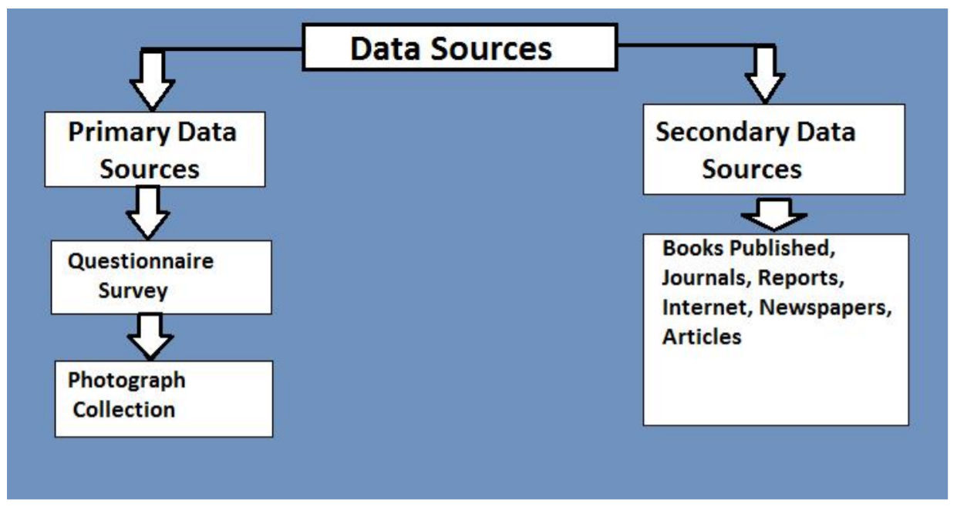

Slide 7
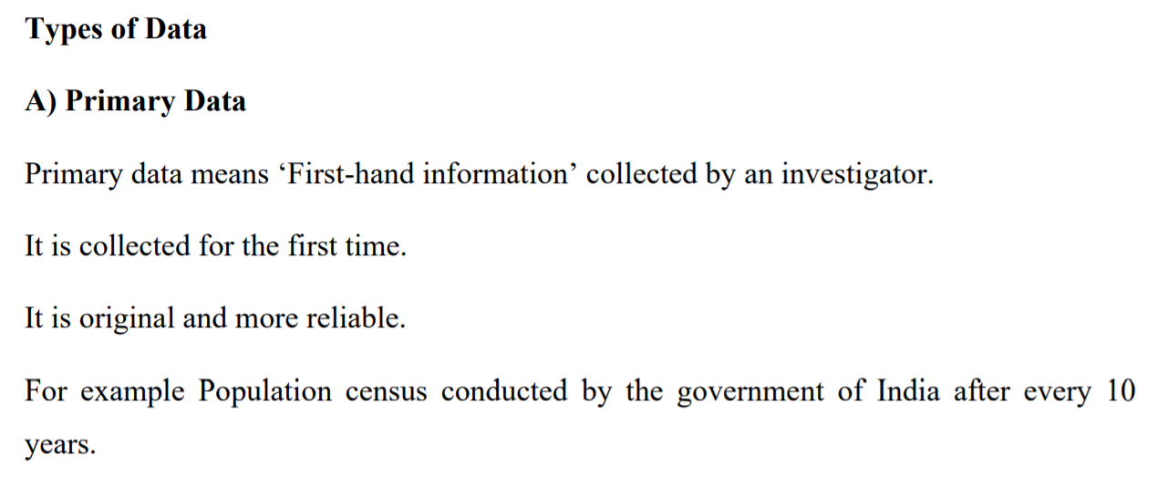

Slide 8
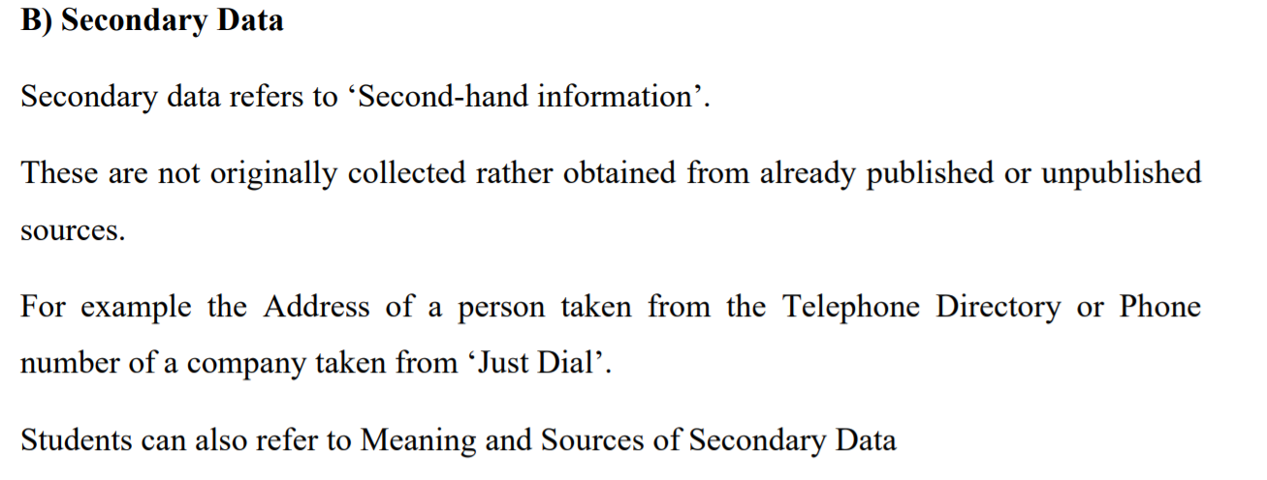

Slide 9
Methods of Collecting Data
Direct Personal Investigation
Indirect Oral Investigation
Information through Correspondent
Telephonic Interview
Mailed Questionnaire
The questionnaire filled by enumerators

Slide 10
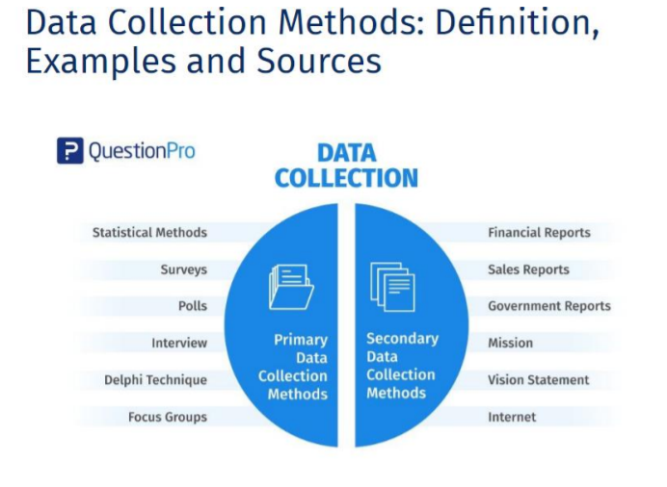

Slide 11
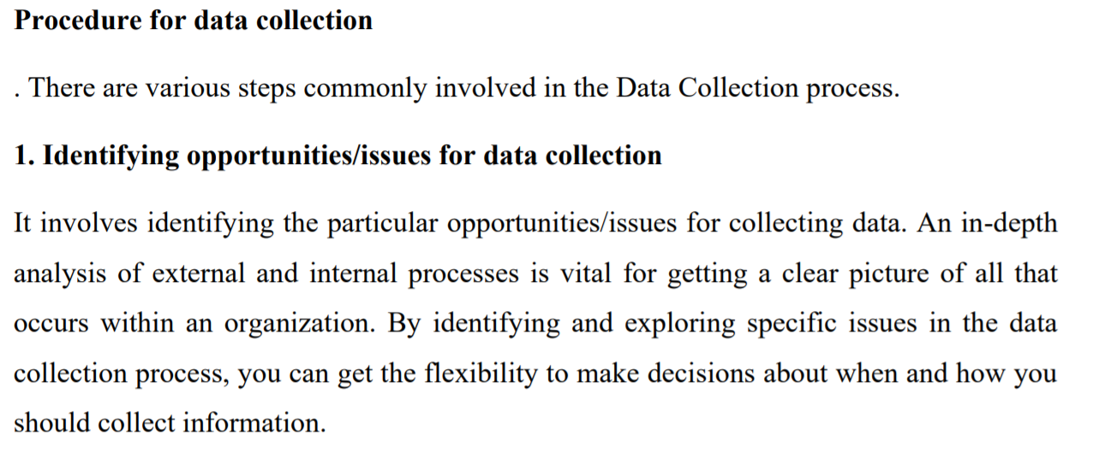

Slide 12
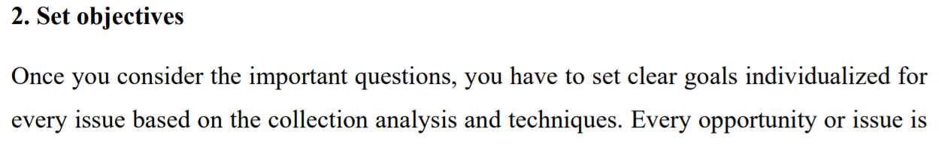
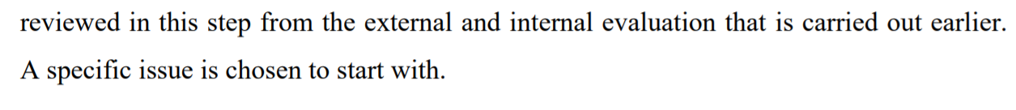

Slide 13
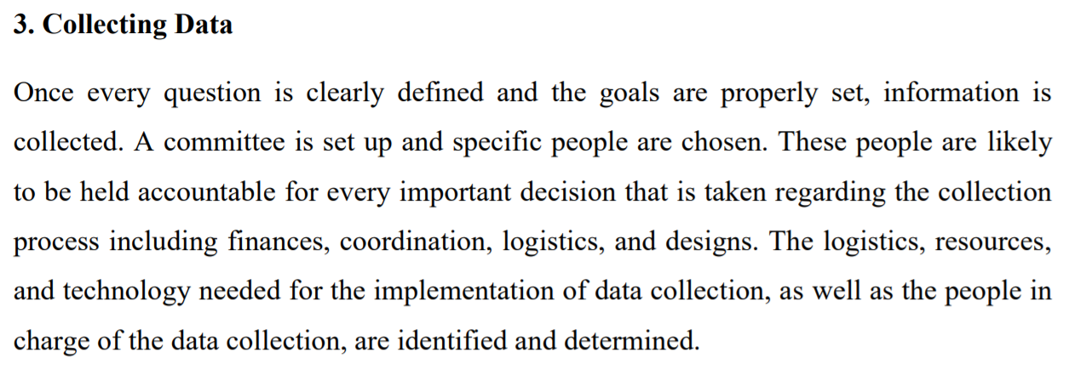

Slide 14
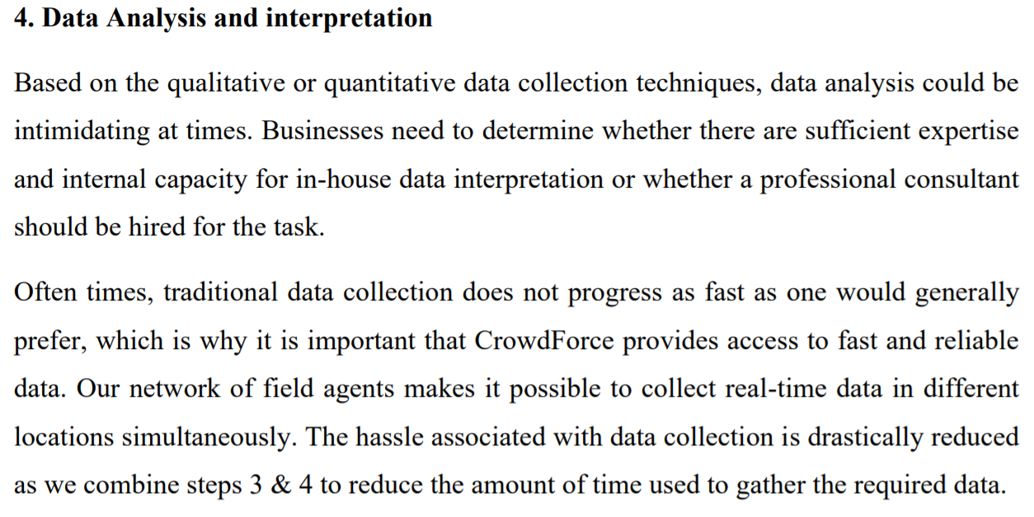

Slide 15
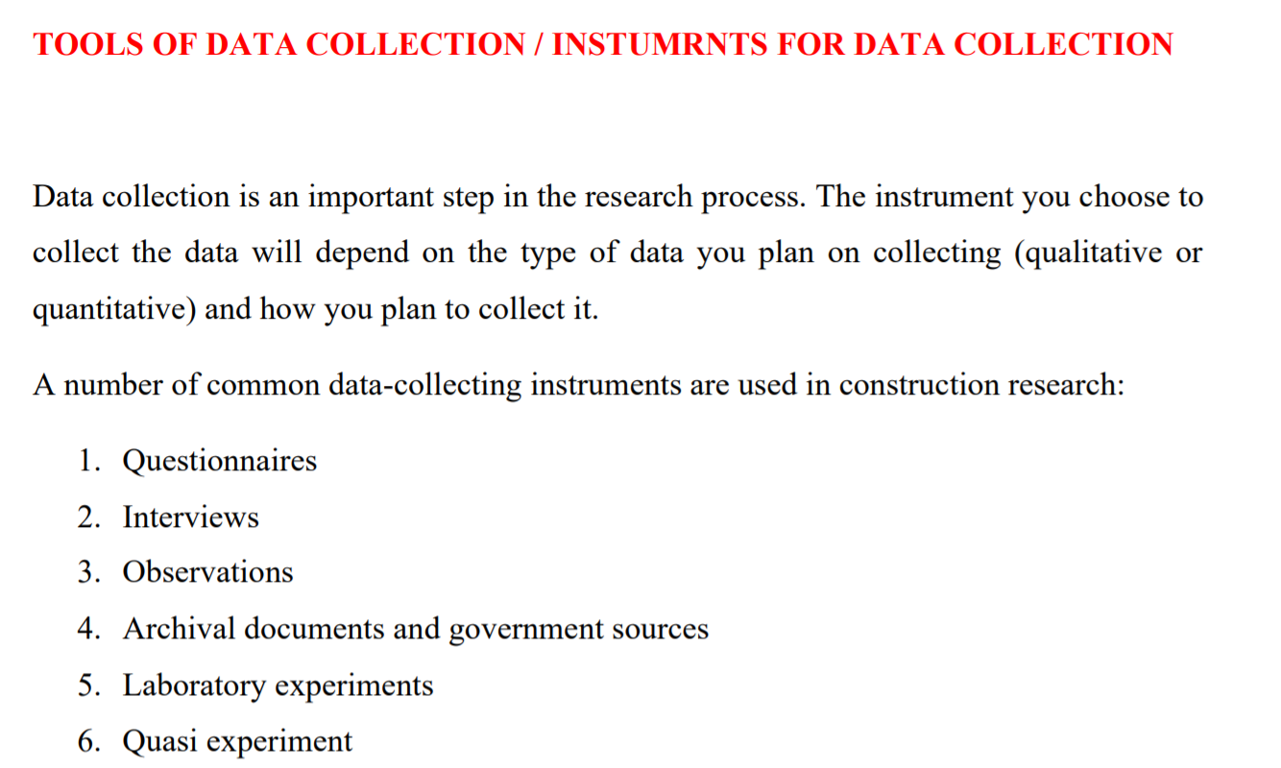

Slide 16
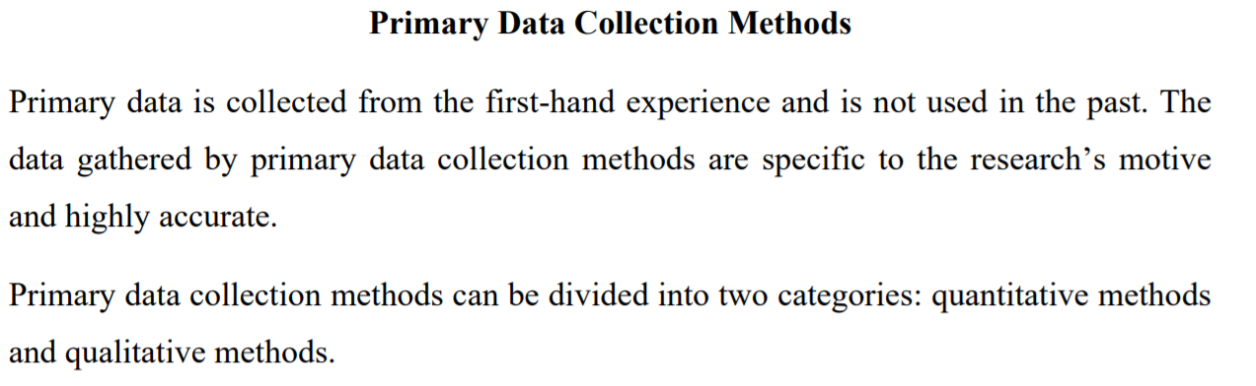

Slide 17
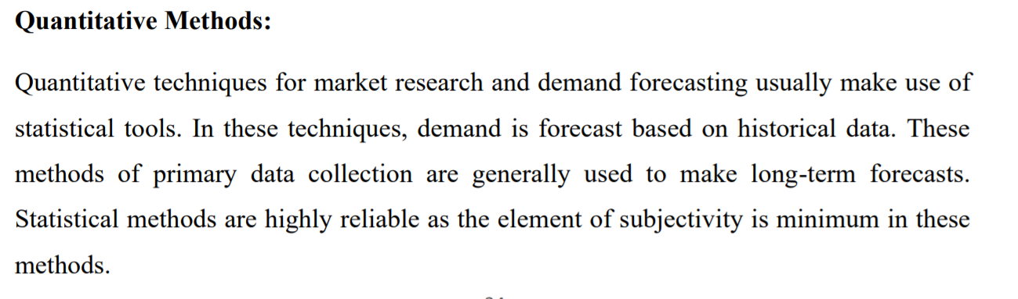

Slide 18
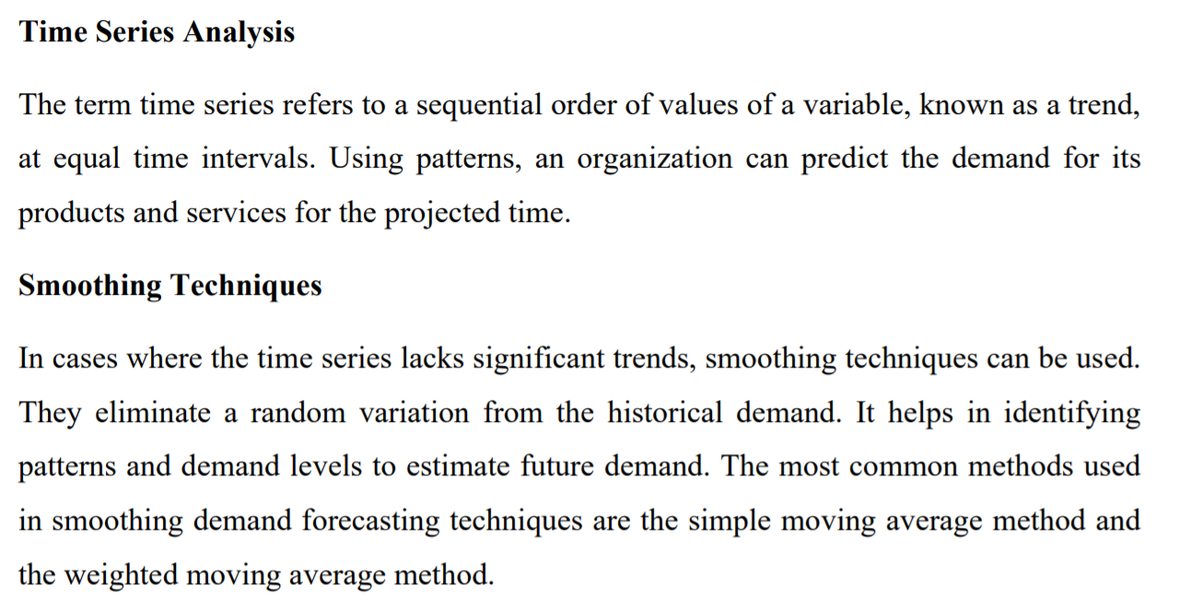

Slide 19
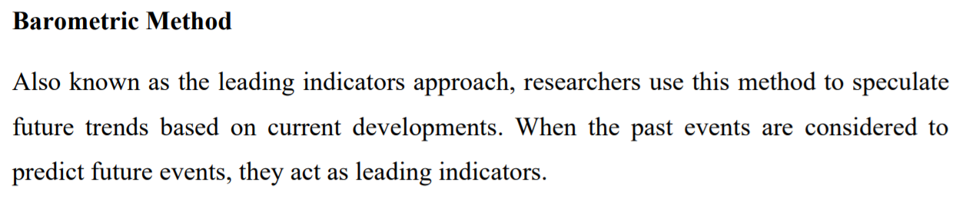

Slide 20
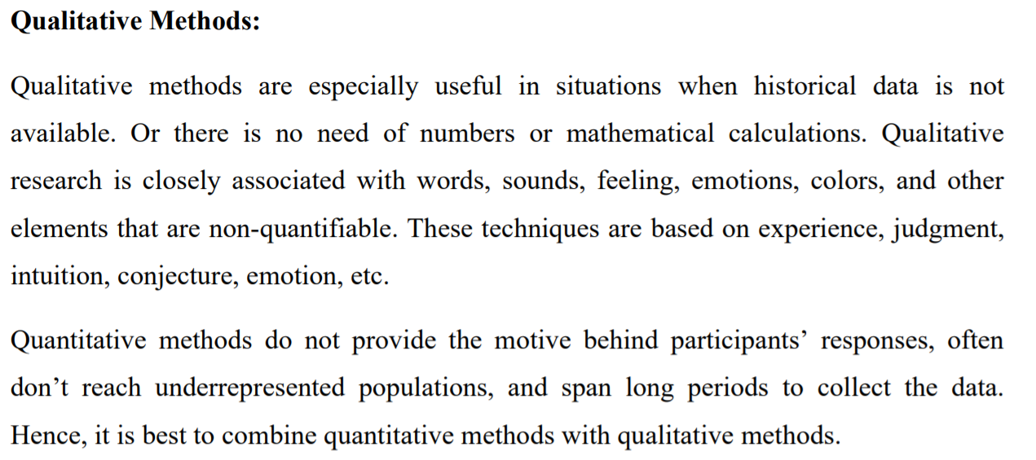

Slide 21
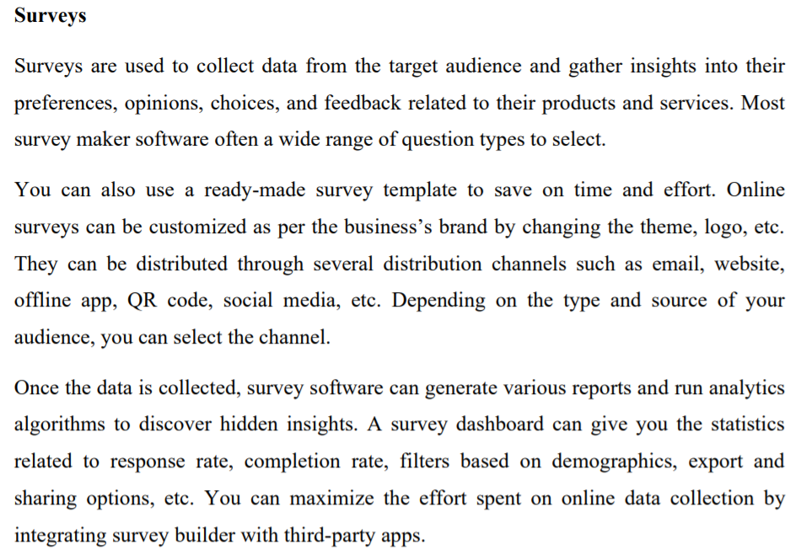

Slide 22
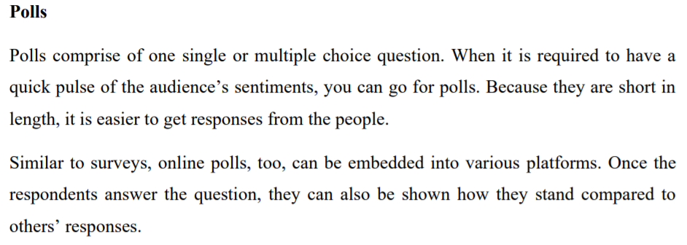

Slide 23
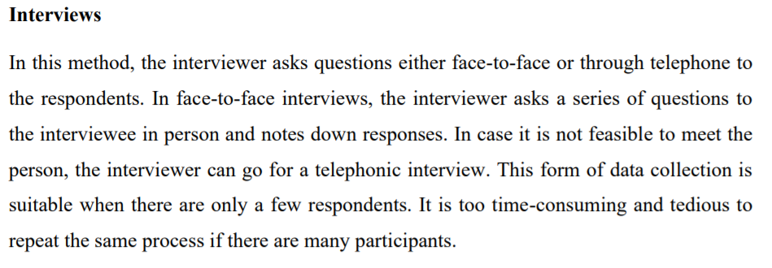

Slide 24
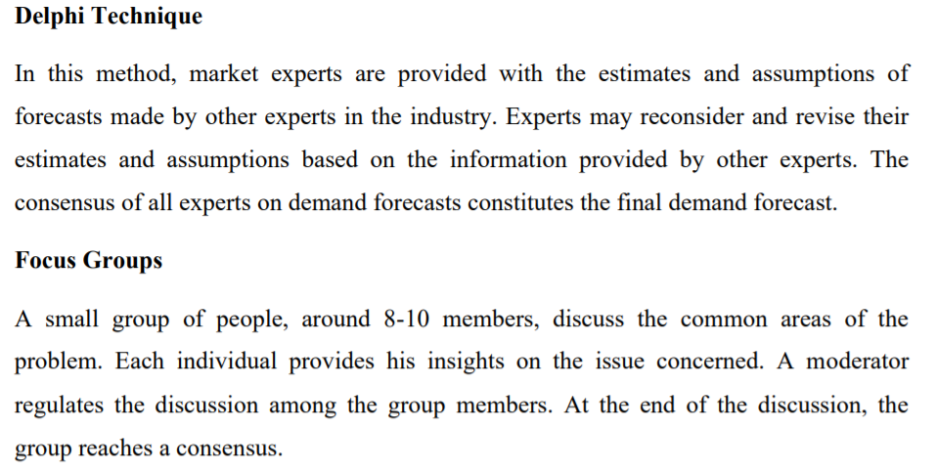

Slide 25
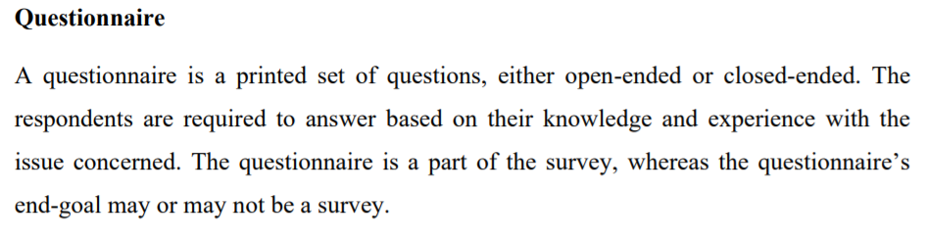

Slide 26
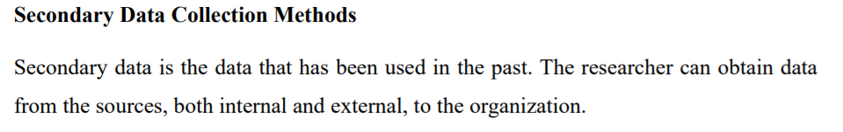

Slide 27
Sources of Secondary Data
Internal Sources
External Sources
Organization’s Health & Safety Records
Mission & Vision Statement
Financial Statement
Magazine
Sales Report
CRM Software
Executive Summaries
Government Report
Press Releases
Business Journals
Libraries
Internet

Slide 28
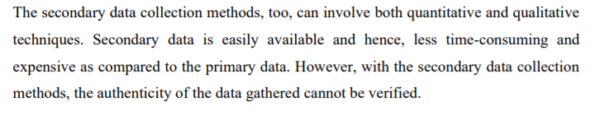

Slide 29
Questionnaire

Slide 30
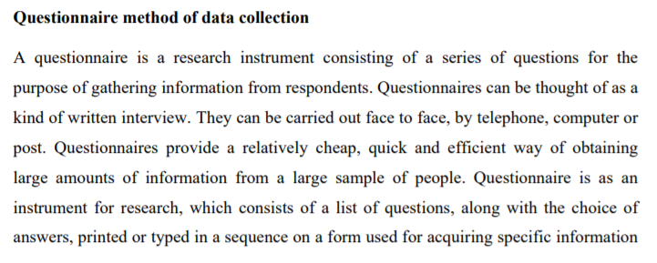
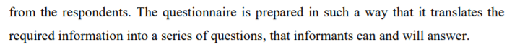

Slide 31
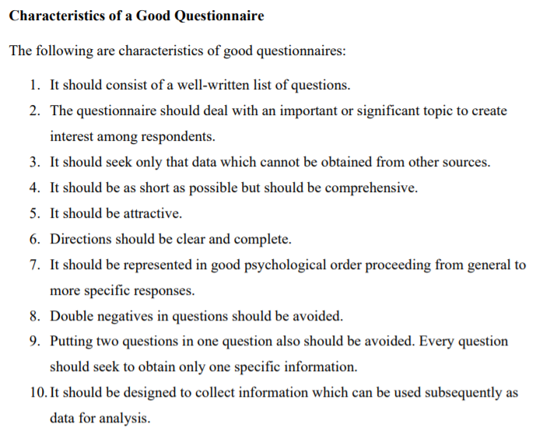

Slide 32
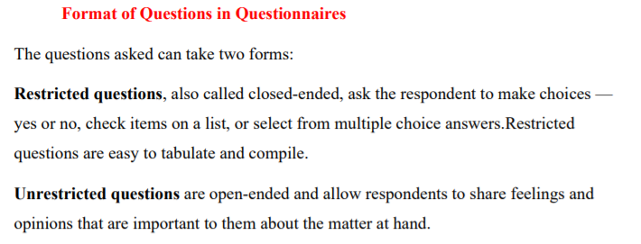
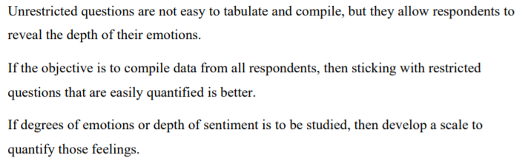

Slide 33
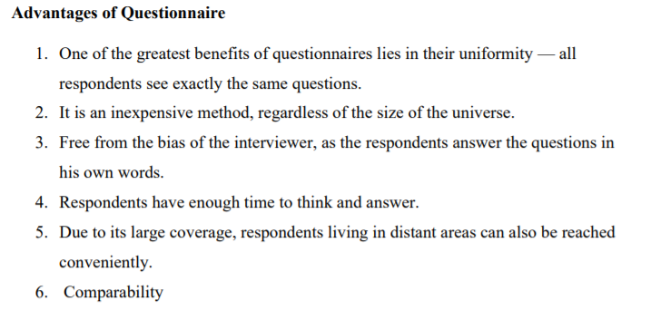

Slide 34
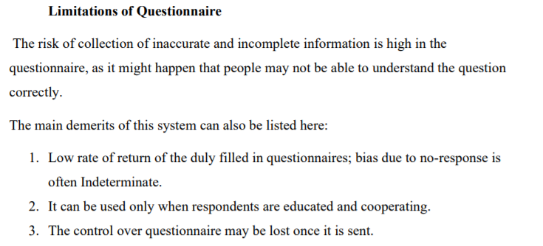
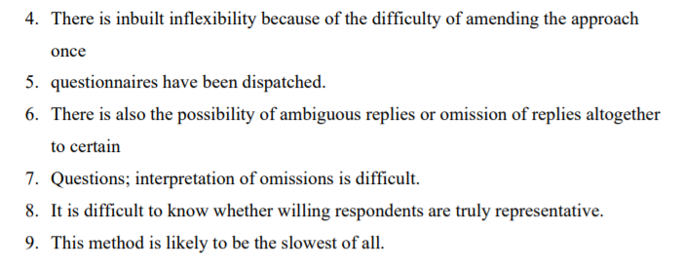

Slide 35
Interviews

Slide 36
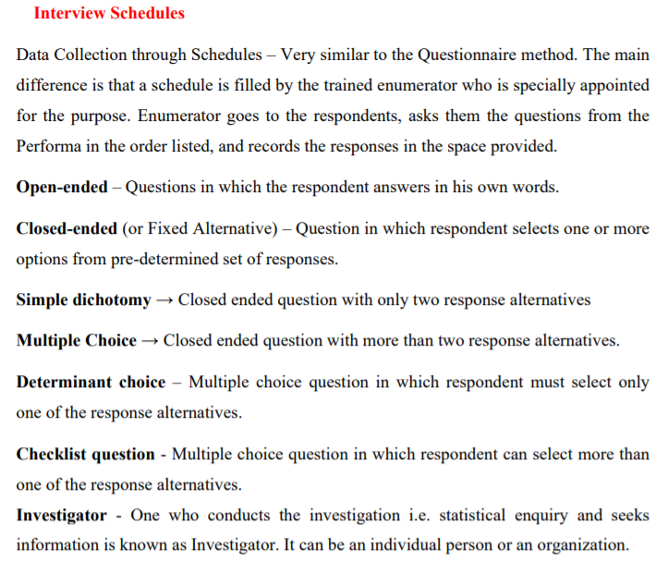
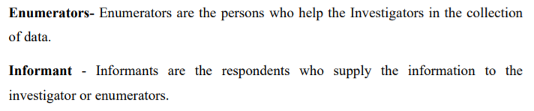

Slide 37
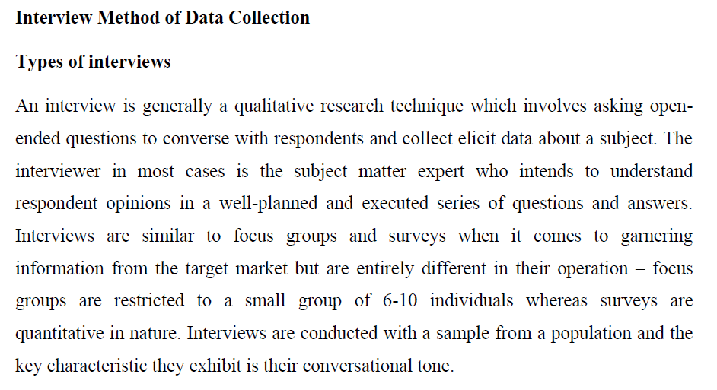

Slide 38
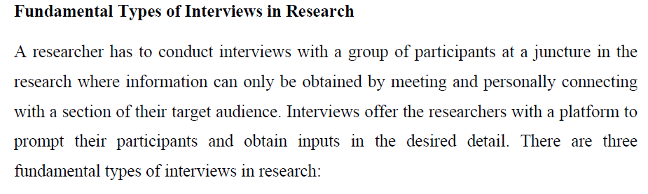

Slide 39
Types of Interviews
Fundamental Types
Structured Interview
Semi Structured Interview
Unstructured Interview

Slide 40
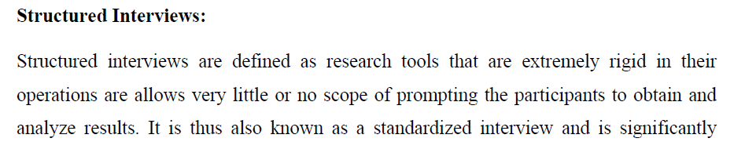
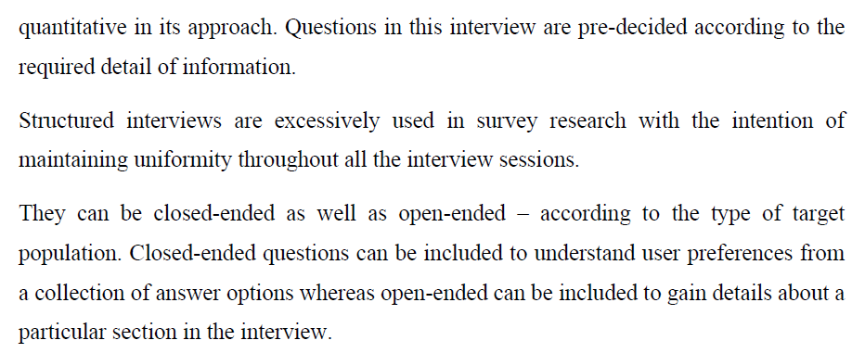

Slide 41
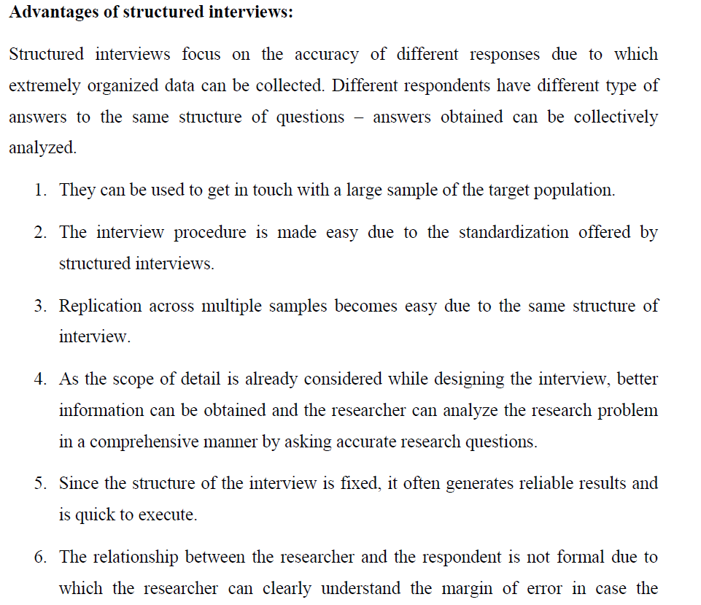

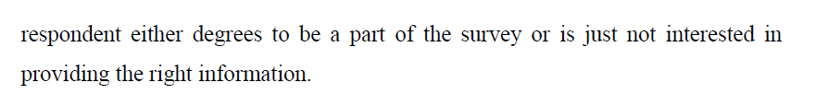

Slide 42
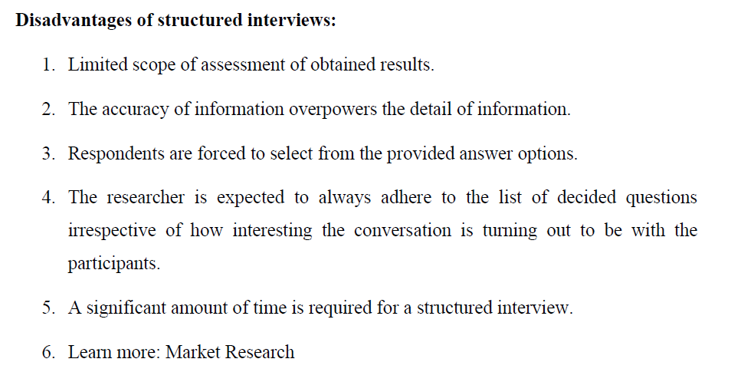

Slide 43
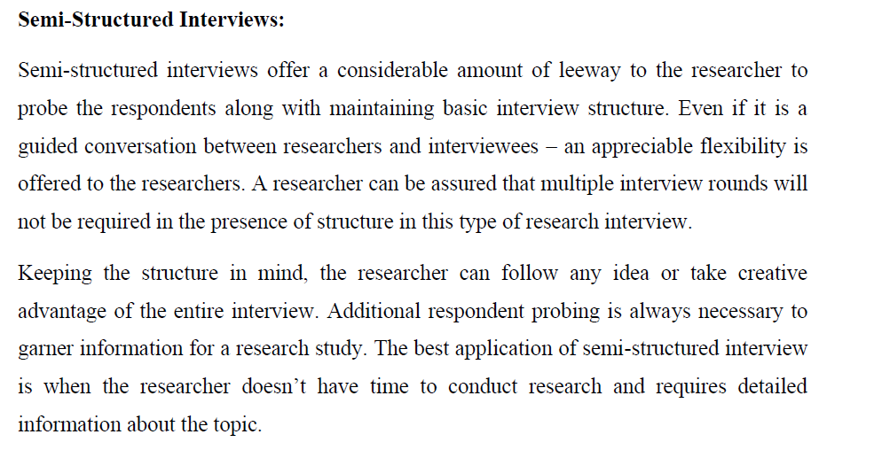

Slide 44
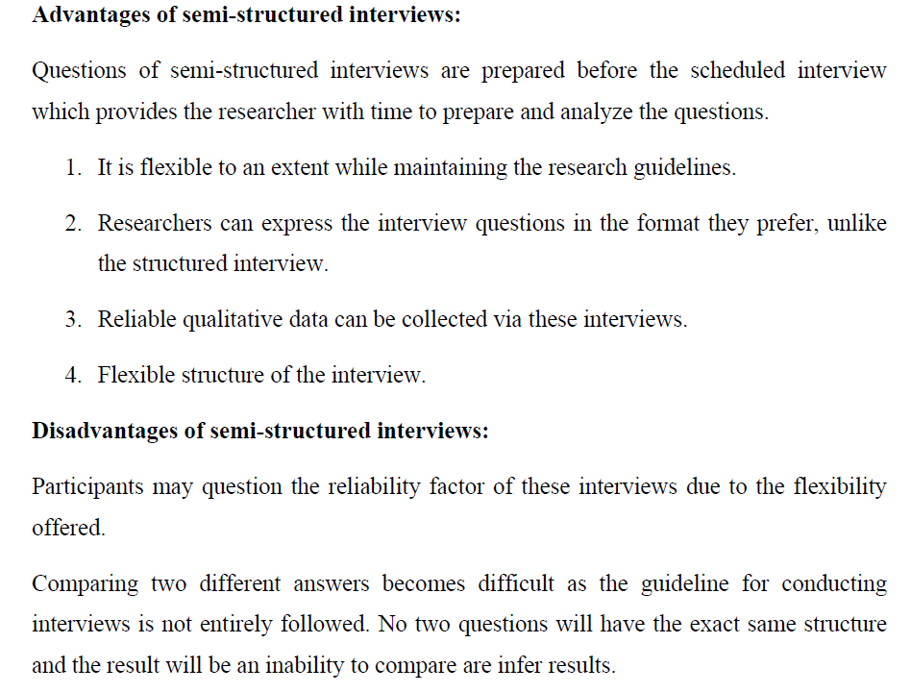

Slide 45
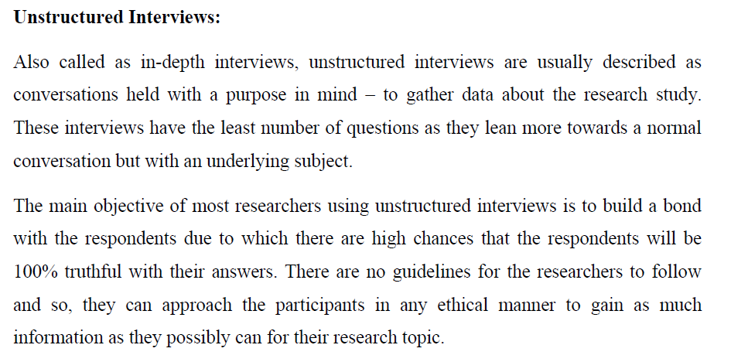

Slide 46
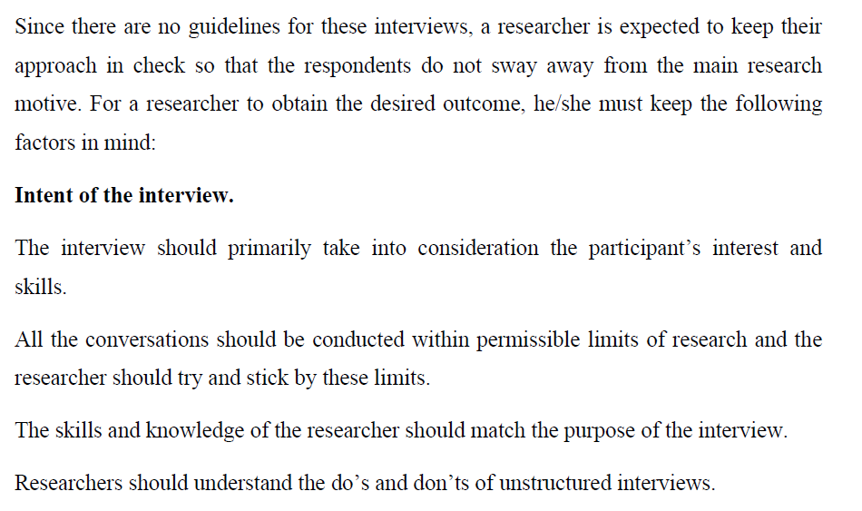

Slide 47
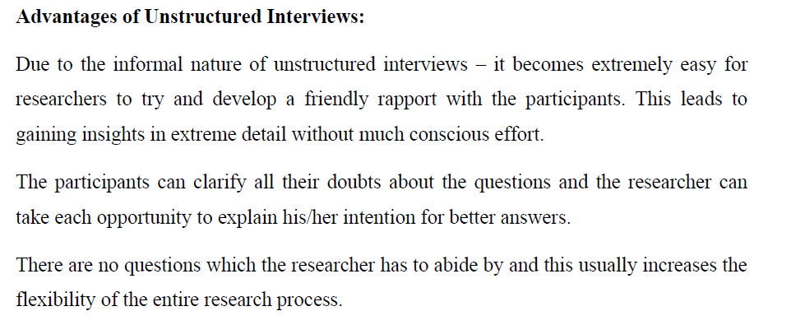

Slide 48
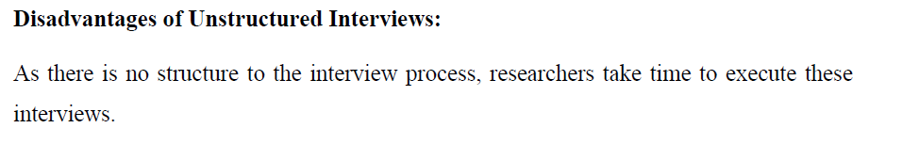
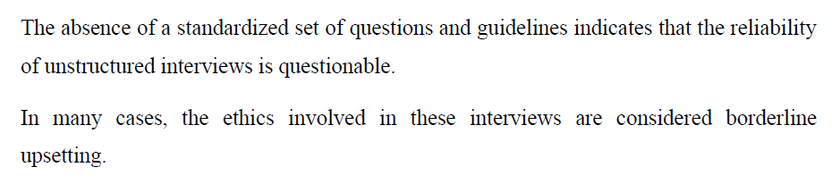

Slide 49
Methods of Interviews
Methods of Research Interviews
Personal Interviews
Telephonic Interviews
Email or Web Page Interview

Slide 50
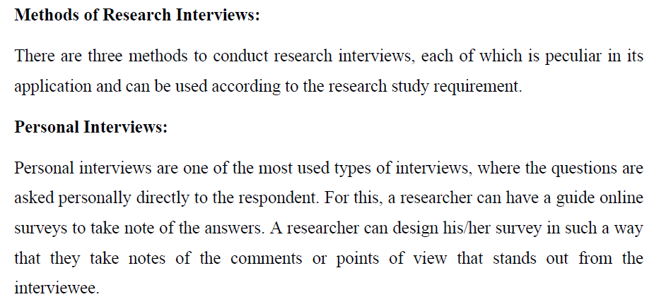

Slide 51
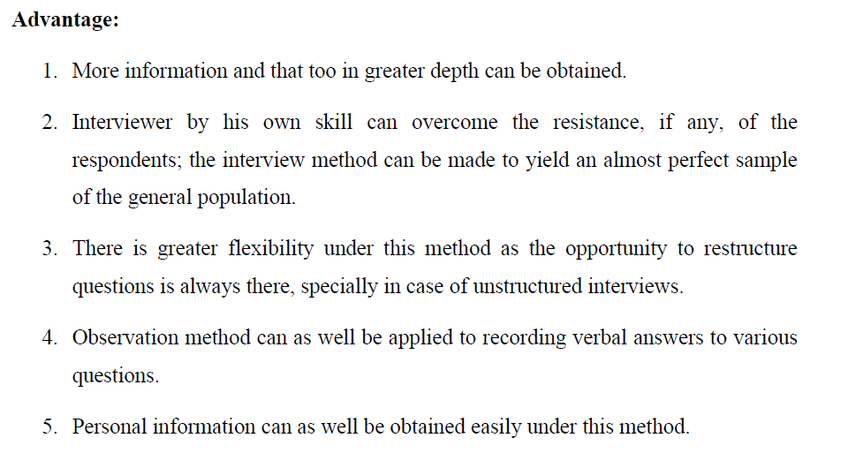

Slide 52
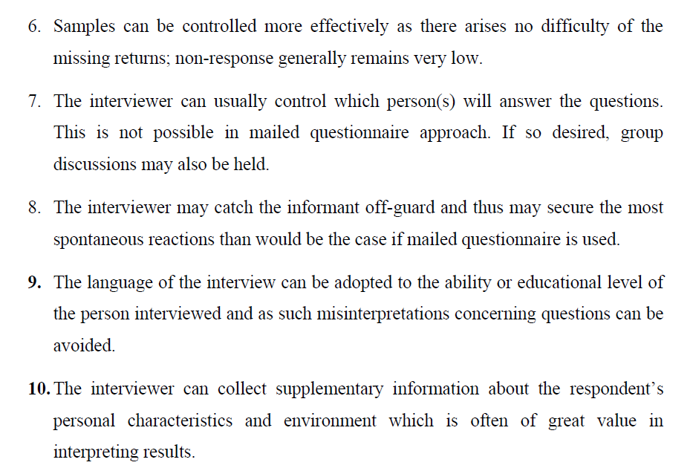

Slide 53
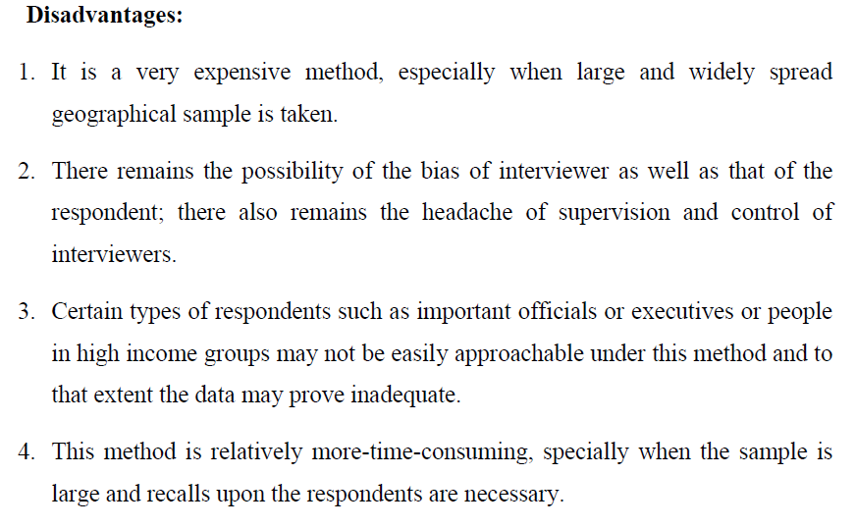

Slide 54


Slide 55


Slide 56



Slide 57


Slide 58


